Slide 1
ABSOLUTE AND COMPARATIVE ADVANTAGE
Dr. Tasiu Magaji

Slide 2
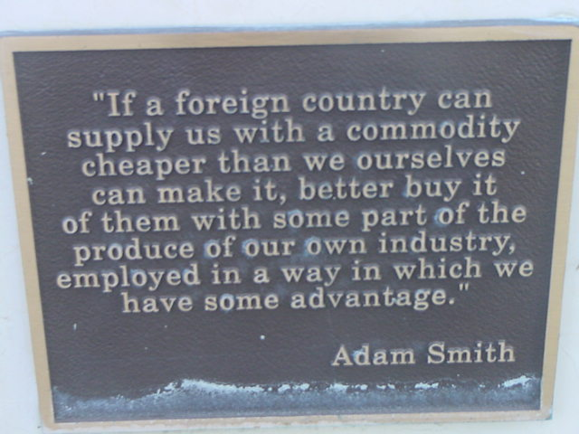

Slide 3
ABSOLUTE ADVANTAGE
It was developed by Adam Smith in his famous book, the Wealth of Nations published in 1776.
It indicated the importance of specialization in production and division of labor.
Smith argued that it was impossible for all nations to become rich simultaneously by following Mercantilism because the export of one nation is another nation’s import.
He maintains that all nations would gain simultaneously if they practiced free trade and specialized in accordance with their absolute advantage.

Slide 4
Smith argued that a country has an absolute advantage in production of a product when it is more efficient than any other country producing it.
It refers to ability of a party to produce more of goods or service than competitors, using the same amount of resources.
Absolute advantage is anything you do more efficiently than anyone else.
Economists use the term absolute advantage when comparing the productivity of one person, firm, or nation to that of another.

Slide 5
Countries should specialize in producing goods or services in which they have an absolute advantage, and then trade with other countries to obtain goods or services in which they lack efficiency.
This specialization and trade would lead to increased efficiency, productivity, and overall economic welfare for all involved parties.

Slide 6
Examples to illustrate the concept of absolute advantage
1. Country A can produce 100 cars with the same amount of resources that Country B uses to produce 50 cars.
In this case, Country A has an absolute advantage in car production because it can produce twice as many cars with the same resources as Country B.
2. Country X can produce 500 shirts with the same amount of resources that Country Y uses to produce 200 shirts.
In this scenario, Country X has an absolute advantage in shirt production because it can produce more shirts using the same amount of resources as Country Y.

Slide 7
Examples to Illustrate the Concept of Absolute Advantage
3. Saudi Arabia has an absolute advantage in the production of oil compared to many other countries.
This is because it has abundant oil reserves and can extract and produce oil at a much lower cost compared to countries that do not have significant oil reserves.
4. The United States has a large agricultural sector and is known for producing a variety of crops, such as soybeans, and wheat, at a lower cost than many other countries due to its fertile soil, advanced farming techniques, and favorable climate.

Slide 8
COMPARATIVE ADVANTAGE
The theory of comparative advantage is an economic concept developed by David Ricardo in his book "Principles of Political Economy and Taxation" in 1817.
It builds upon the theory of absolute advantage.
It suggests that countries should specialize in producing goods or services in which they have a lower opportunity cost of production, rather than focusing solely on their absolute advantage.
a country has a comparative advantage in producing a good or service if it can produce it at a lower opportunity cost compared to another country.

Slide 9
COMPARATIVE ADVANTAGE
Opportunity cost is the value of the next best alternative that must be given up in order to produce a particular good or service.
By specializing in the production of goods or services with the lowest opportunity cost, countries can allocate their resources more efficiently and achieve a higher level of productivity.
Comparative advantage recognizes that even if a country is more efficient in all areas of production (absolute advantage), there are still gains to be made from specialization and trade.
By focusing on producing goods or services where they have a comparative advantage, countries can trade with each other and both benefit from the exchange.

Slide 10
COMPARATIVE ADVANTAGE
This is because each country can obtain goods or services at a lower opportunity cost through trade than if they had to produce everything domestically.
Ricardo's theory of comparative advantage implies that trade can be mutually beneficial even when one country is more efficient in all areas of production.
The theory of comparative advantage is widely accepted and forms the basis of modern international trade theory.
It highlights the benefits of specialization, exchange, and division of labor among countries, leading to increased global efficiency, economic growth, and welfare.

Slide 11
Examples to Illustrate the Concept of Comparative Advantage
1. Trade between the United States and Mexico:
The United States has a comparative advantage in producing high-tech goods, such as computers due to its highly skilled workforce and advanced infrastructure.
Mexico, on the other hand, has a comparative advantage in producing labor-intensive goods, such as textiles and agriculture, due to its lower labor costs.
As a result, the two countries engage in trade, with the United States exporting high-tech goods to Mexico in exchange for Mexican exports of labor-intensive goods.

Slide 12
Examples to Illustrate the Concept of Comparative Advantage
Trade between China and Japan:
China has a comparative advantage in producing low-cost manufactured goods, such as clothing and electronics, due to its large population and low labor costs.
Japan, on the other hand, has a comparative advantage in producing high-tech goods, such as automobiles due to its advanced technology and skilled workforce.
As a result, the two countries engage in trade, with China exporting low-cost manufactured goods to Japan in exchange for Japanese exports of high-tech goods.

